Slide 1
E-retail factors for customer activation and retention: A case study from Indian e-commerce customers

Slide 2
Overview
Customer satisfaction has emerged as one of the most important factors that guarantee the success of online stores; it has been posited as a key stimulant of purchase, repurchase intentions, and customer loyalty. A comprehensive review of the literature, theories, and models has been carried out to propose the models for customer activation and customer retention.
Five major factors that contributed to the success of an e-commerce store have been identified as service quality, system quality, information quality, trust, and net benefit. The research furthermore investigated the factors that influence online customers to repeat purchase intention. The combination of both utilitarian values and hedonistic values is needed to affect the repeat purchase intention (loyalty) positively. The data is collected from Indian online shoppers. Results indicate the e-retail success factors, which are very much critical for customer satisfaction.

Slide 3
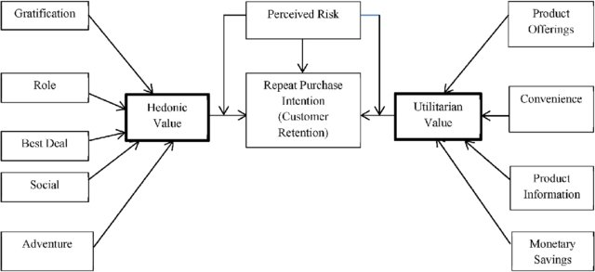

Slide 4
ABOUT DATASET
The dataset contains several columns. Columns describe each and every general information regarding online shopping. Customer behavior regarding online shopping and about different-different shopping applications etc.

Slide 5
Problem statements
In this dataset we need to find out how many people get indulge in online shopping. What is the most indulged gender in online shopping
How to deal the customers who are not involved much in online shopping.

Slide 6
Tools
I have used several EDA (Exploratory Data Analysis in this project) for studying the dataset.
Further, I have used visualization techniques like plotting different graphs for visualizing and better understanding the dataset.

Slide 7
Summary
In this dataset, we would find several information, like: mostly which gender do prefer online shopping and how much do they shop in the last 1 year or from last how many years. Several questions and answers from the customer’s side. what age group is mostly indulged in online shopping and from which application?
Which web browser is highly used by the customers? What device do customers use the most and which Internet access? Cities from where customers prefer to do online shopping. Did customers find online shopping enjoyable, relevant, and trustable, which application do they trust the most or used the most all over India? which application do customers trust the most regarding their Personal and General information? which application gives high satisfaction to customers, and solves their problems regarding replacement or any other issues. Which application is highly recommended for online shopping. I have also compared some columns for better results and information.

Slide 8
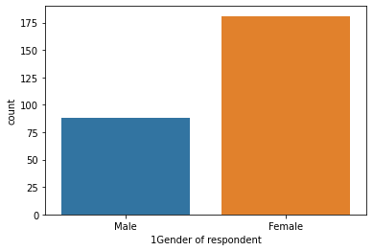
Observation: As we can see Female customers shops more compared to Male customers. And there is a huge difference between the observation of both . as u can see in the graph.

Slide 9
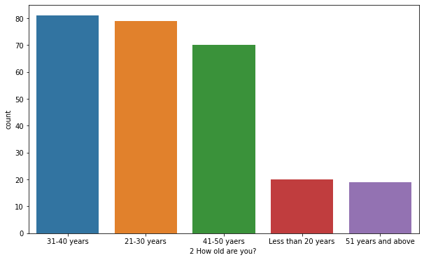
Observation: Costumers under the age group 31-40 years shop more. 80% of the customers come under this age group Costumers under the age group 21-30 years shop for around 78% Costumers under age group 41-50 years shop around 70% Costumers under the age group then less than 20 years shop for around 20% Costumers under the age group last 51 years and above shop around 20% There is a small difference between the age groups (31-40) and (21-30) so, here it represents that these age group costumes used online shopping most. There is a little difference between less than 20 and 51 years and above, those customers prefer online shopping less.

Slide 10
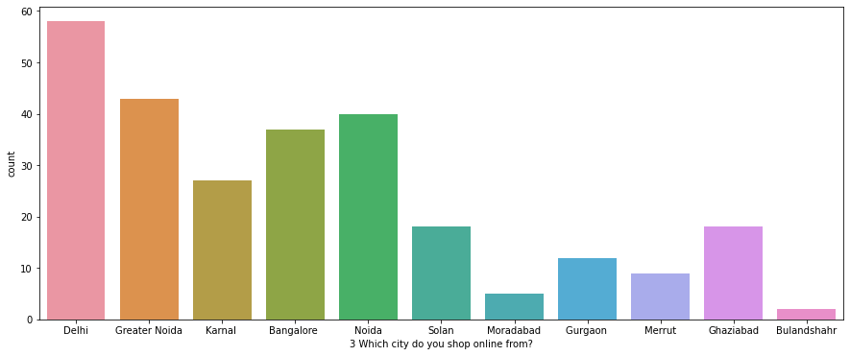
Observation: Most customers prefer to do online shopping from DELHI around 58% of customers prefer Delhi. Delhi, Greater Noida, and Noida are the top 3 cities for costumes shop online. And costumers prefer less for online shopping from BULANDSHAHR less than 5% costumers. Bulandshahr, Moradabad , and Merrut are at least 3 cities customers not prefer online shopping

Slide 11
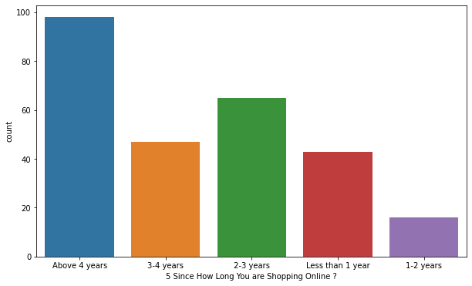
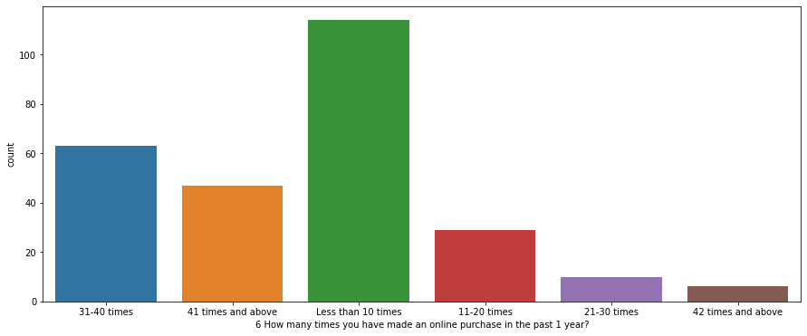
Comparing the age group and online purchase in last 1 year
Observation: In the past 1 year less than 10 times we have made an online purchase.
most of the customer are not indulge in online shopping in the last 1 year it is less than 10 times only. it is
above than 100%
Observation : 80% of customers are shopping from above 4 years.
Around 50% costumers are shopping from 3-4 years.
Around 65% costumers are shopping from 2-3 years.
Around 45% costumers are shopping from less than 1 years
Around 18% costumers are shopping from 1-2 years

Slide 12
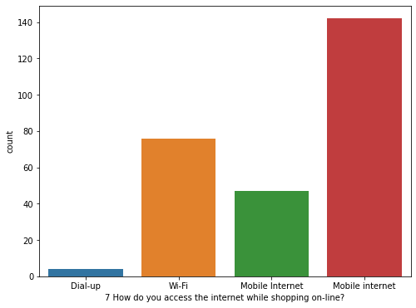
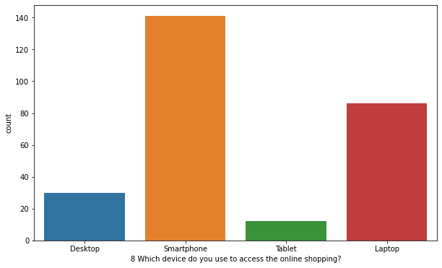
Comparing internet connection and device used most by the customers
Observation : Costumer use Mobile Internet mostly while online shopping around 140% costumers use mobile internet for online
shopping
And Wi-Fi is used by around 78% costumers.
Dial-up is used by less than 10% costumers.
Observation : Smartphones are highly used for online shopping over 130% of costumer prefer to use smartphone for online
shopping
Around 90% of the costumers prefer Laptop for online shopping
Around 30% of the costumers prefer Desktop for online shopping
Less than 20% of the costumers prefer Tablet as their source for online shopping

Slide 13
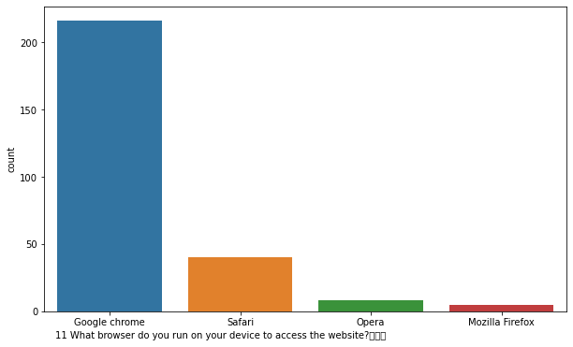
Observation: Google Chrome is a highly used browser customers run for accessing the website more than 200% customers use Google Chrome Safari is used by around 45% of the costumers Opers are used by less than 15% of the costumers Mozilla Firefox is the least used browser among all of the browsers less than 10% of customers use.

Slide 14
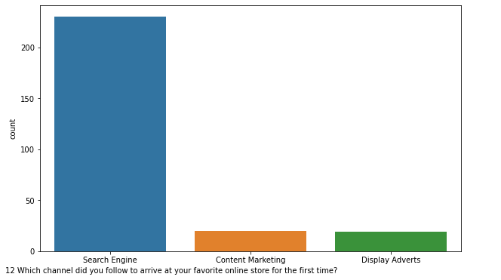
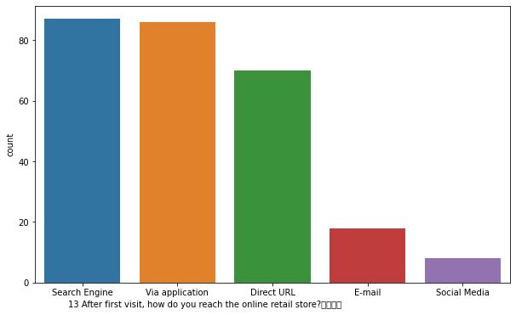
Comparing which channel is used for the first visit and first experience
Observation : Search Engine Channel is highly used by the costumers for first time online store experience.
more than 200% of costumers.
Content Marketing around 30%
Display Adverts around 25%
Observation : Around 90% of costumers used Search Engine and Via applications to retail online store after first visit.
Around 70% of costumers used Direct URL
Around 18% of costumers used E-mail
Around 15% of costumers used Social Media.

Slide 15
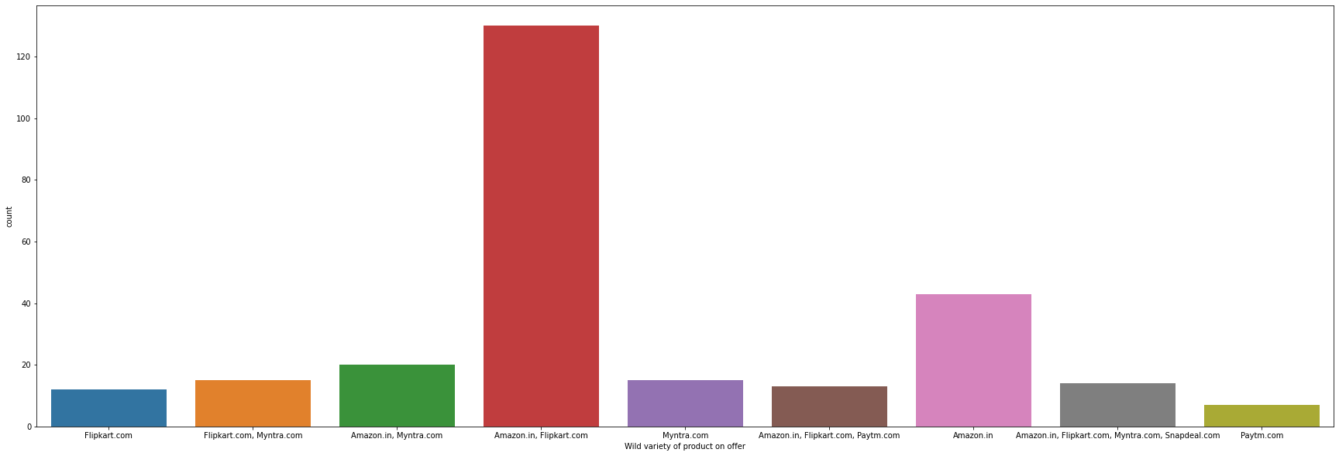
Observation : Above 120% customer states that on Amazon , Flipkart there are wild variety of products on offers Around 50% on Amazon. in Around 30% on Myntra and Amazon Around 20% on Flipkart and Myntra less than 10% on Paytm.com

Slide 16
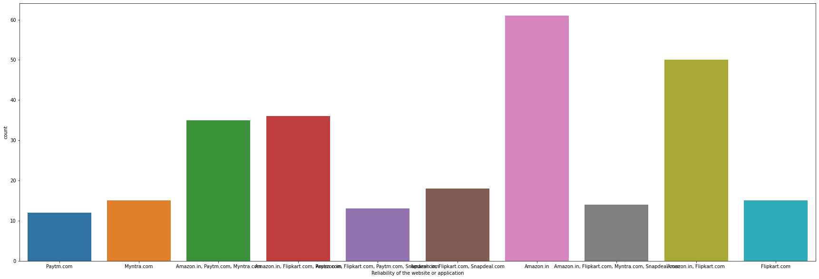
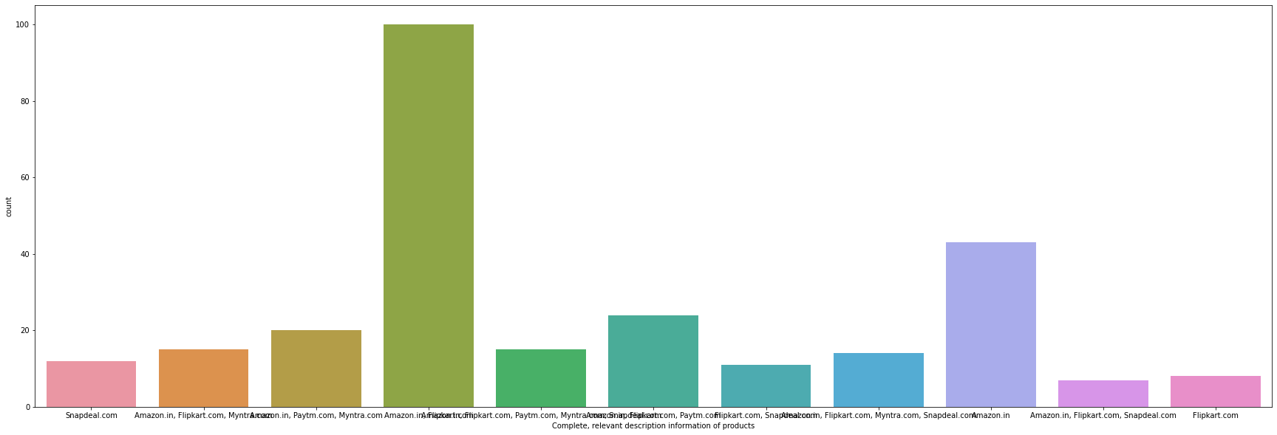
Comparing reliability and relevant description
Observation : 61% of customers find Amazon.in as reliable application
50% of customers find both Amazon and Flipkart as relaiable application
15% of customers find both Myntra and Flipkart as relaiable application
12% of customers find Paytm.com as relaiable application
Observation : Amazon and Flipkart give 100% complete and relevant description of products which helps customers for making
decision while shooping
Around 24% of customers find Amazon and Flipkart helpful while it provide complete description about the product
Around 12% of customers find Snapdeal helpful while it provide complete description about the product
Around 11% of customers find Flipkart and Snapdeal helpful while it provide complete description about
the product
Around 8% of customers find Flipkart helpful while it provide complete description about the product

Slide 17
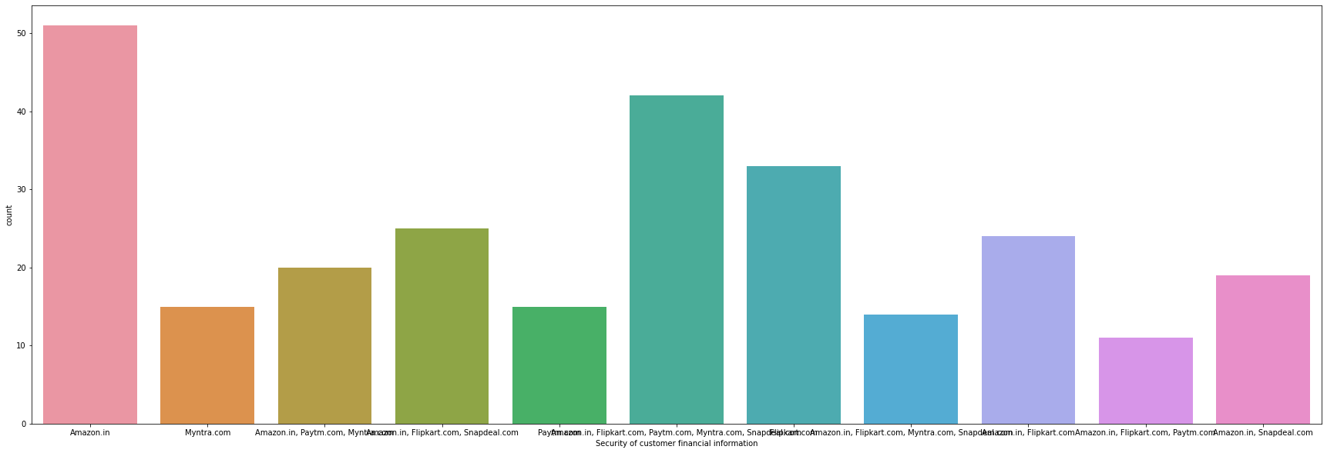
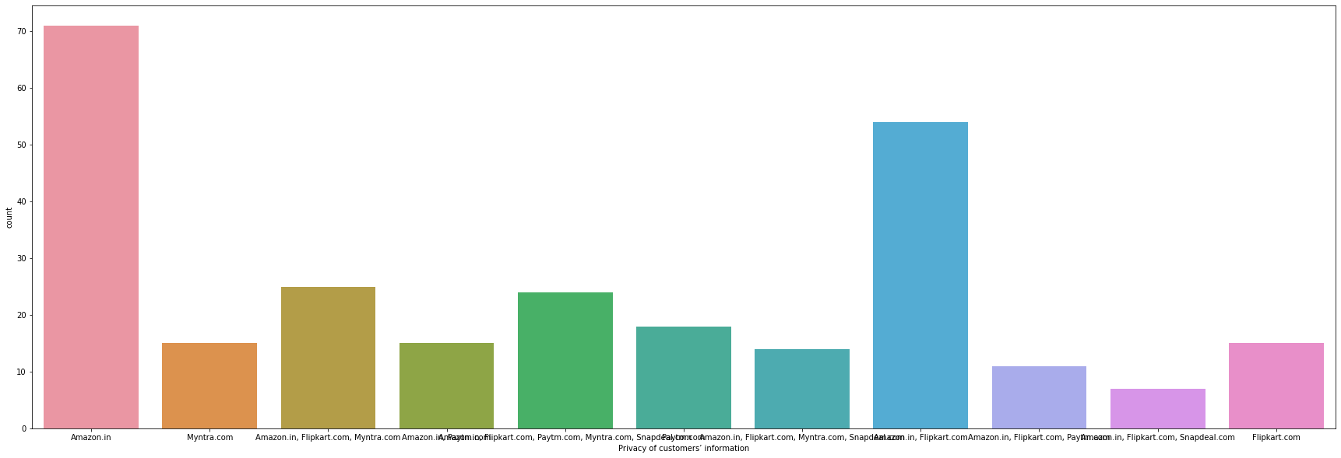
Comparing security and privacy of customer’s information
# Observation : Around 51% of customers trust Amazon for security regarding customers finanicial information
Around 33% of customers trust Flipkart for security regarding customers finanicial information
Around 15% of customers trust Myntra for security regarding customers finanicial information
Around 15% of customers trust Paytm for security regarding customers finanicial information
Observation : Around 71% of customers trust Amazon for privacy of customer's information
Around 54% of customers trust both Amazon and Flipkart for privacy of customer's information
Around 18% of customers trust Paytm for privacy of customer's information
Around 15% of customers trust both Myntra and Flipkart for privacy of customer's information

Slide 18
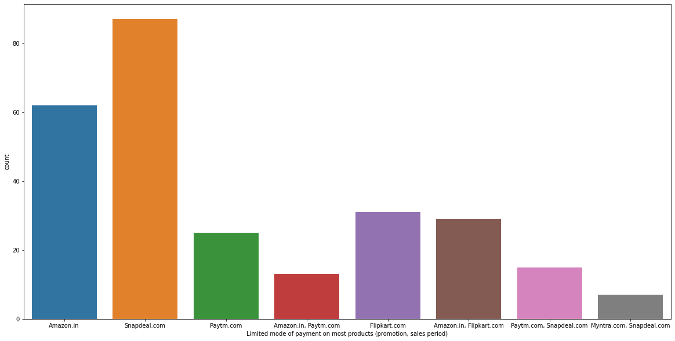
observation: Snapdeal gets 87% customer votes for Limited mode of payment on most products. Amazon gets 62% customer votes for Limited mode of payment on most product. Flipkart 31% customer votes for Limited mode of payment on most product. Amazon, Flipkart gets 29% customer votes for Limited mode of payment on most product. Paytm gets 25% customer votes for Limited mode of payment on most product. Snapdeal, Paytm gets 15% customer votes for Limited mode of payment on most product. Amazon, Paytm gets 13% customer votes for Limited mode of payment on most product. Myntra , Snapdeal gets 7% customer votes for Limited mode of payment on most product.

Slide 19
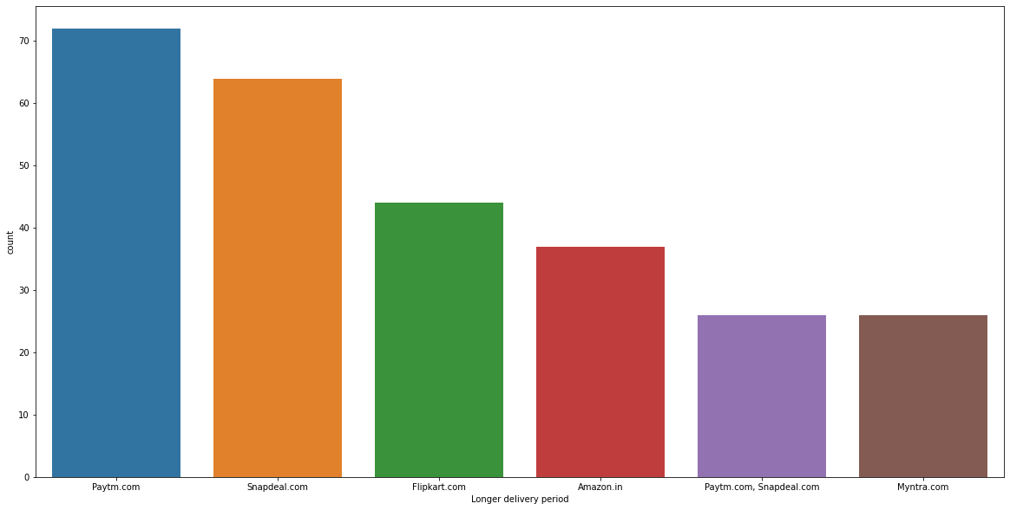
observation: Paytm gets 72% customer votes for Longer delivery time. Snapdeal gets 64% customer votes for Longer delivery time. Flipkart 44% customer votes for Longer delivery time. Amazon gets 37% customer votes for Longer delivery time. Snapdeal, Paytm gets 26% customer votes for Longer delivery time. Myntra gets 26% customer votes for Longer delivery time.

Slide 20
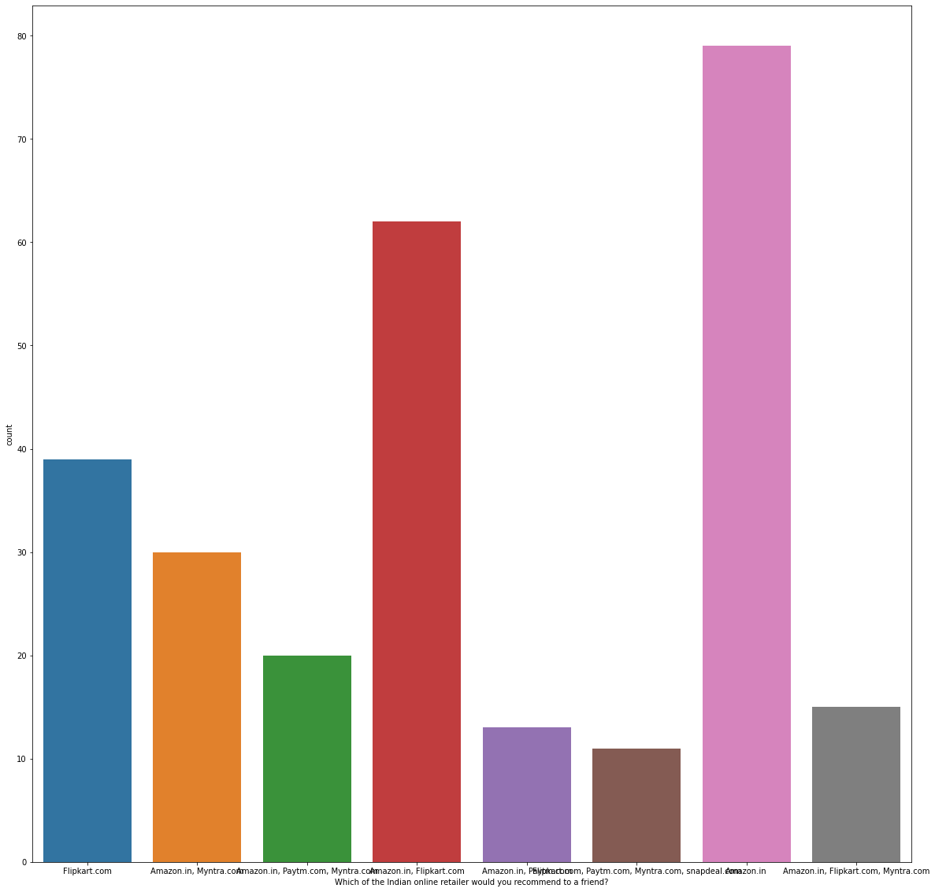
Observation : 79% of customer recommend Amazon all over India for online retailer 62% of customer recommend both Amazon and Flipkart all over India for online retailer 39% of customer recommend Flipkart all over India for online retailer 30% of customer recommend both Amazon and Myntra all over India for online retailer 13% of customer recommend both Amazon and Paytm all over India for online retailer

Slide 21
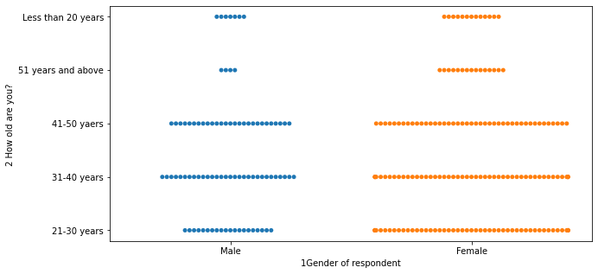
Observation :- In the age group between (21-30YEARS) Females use more online shopping
In the age group between (31-40YEARS) Females use more online shopping In the age group between (41-50YEARS) Females use more online shopping In the age group between (51-60YEARS) Females use more online shopping In the age group between (61-70YEARS) Females use more online shopping
As you can see Females of every age group use online shopping more in comparison to Males

Slide 22
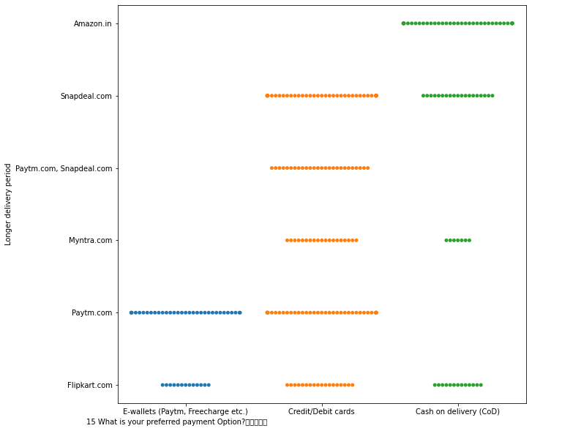
# Observation :- In E-wallets(Paytm,Freecharge etc) payment method. Paytm.com and Flipkart.com are more prefered. In Credit/Debit cards payment method. Paytm.com, Flipkart.com, Myntra.com and Snapdeal.com are more prefered. In Cash on delivery(COD) payment method. Flipkart.com, Myntra., Snapdeal.com and Amazon.com are more prefered.

Slide 23
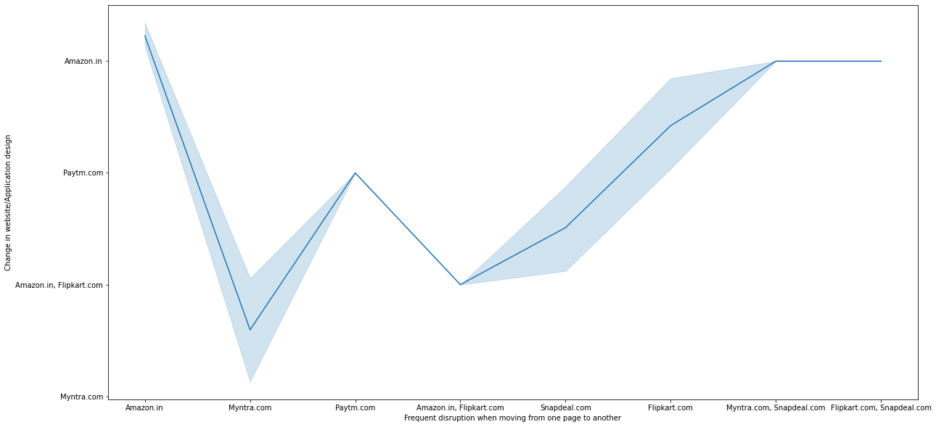
Observation : Amazon have the most frequent disruption while moving from one page to another and change in application design Flipkart is less than Amazon for frequent disruption while moving from one page to another and change in application design After Flipkart it is seems that Snapdeal is frequent disruption while moving from one page to another and change in application design Myntra is showing the least frequent disruption while moving from one page to another and change in application design

Slide 24
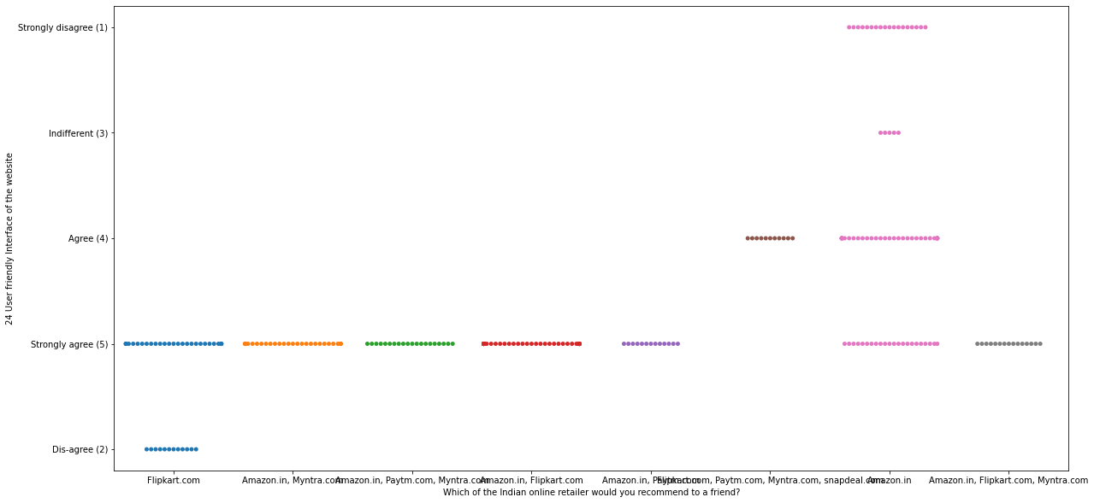
# Observation: Amazon is a highly recommended application. Flipkart is the second highly recommended application. Myntra is on number 3 Paytm on number 4 and Snapdeal is selected to be the least recommended application by the customers.

Slide 25
Conclusion
Here i conclude that most of the customers are female and the frequest or active customers are from age group (31-40) and
(21-30) years. Delhi , Greater-Noida , Noida are find to be top 3 cities where customer shop more online while Merrut ,
Bulandshahr , Moradabad are find to be least shoped cities . There are 80% of customers those are shooping and loyal from
last 4 years and around 65% customers shop from last 2-3 years. where as we have also seen that there are customers those
dont shop from last 1 year for making them purchase we would provide special offers , coupons to them so they get involved
in shopping . Mostly customers use Smartphone and Mobile internet for shopping online .Customers highly use Google Chrome
to access the application . Search engine and Via application are mostly used by costumers to retail online shop after first
visit .Most of the customers take around 15 min for exploring the E-retail store before making any purchase. Most of the payment
are made through Credit/Debit cards.
Most of the Costumers also find Online shopping is convinent and flexible . they find online shopping is enjoyable and online
shooping also provide monetary benefits and discounts and responsivness . Customers are highly satisfied with the security and
privacy regarding their general and financial information . Return and replacement policy is much important for the customers
As users satisfaction cannot exist without trust . It put alot of effort to remain that trust . Cutomers find it much more
easier as they find relevant information about each and every product while purchasing .
It is find from abone analysis that , AMAZON is the most used ,trusted online shooping application . Customers find online
shopping much easier with Amazon . and Amazon is highly recommended online shooping application all over India.
After Amazon customers find Flipkart and used it for online shopping
Paytm.com is leats shopped from but it is highly used by the costumers for several end to end transaction . costumers trust
Paytm.com for their transaction.

